Slide 1

CMR COLLEGE OF ENGINEERING & TECHNOLOGY
Kandlakoya, Medchal, Hyderabad - 501401
Department of Computer Science and Engineering- Cyber Security
Industrial Oriented Mini Project

Slide 2

INTRUSION DETECTION USING SURICATA AND IP TRACKING
Under esteemed guidance of
Dr. R. Venkateswara Reddy
BATCH-19
Sabhavath Sadhana - 22H51A6244
Vancha Pranav - 22H51A6259
K. Vishnu Vardhan - 23H55A6204

Slide 3
Outline
Abstract
Introduction
Literature Review
Existing Solutions
Advantages
Procedure
Flow Chart
Block Diagram
System Requirements
Results
Conclusion

Slide 4
Abstract

Slide 5
Abstract
Now a days, online social media is dominating the world in several ways. Day by day the number of users using social media is increasing drastically. The main advantage of online social media is that we can connect to people easily and communicate with them in a better way. This provided a new way of a potential attack, such as fake identity, false information, etc. A recent survey suggests that the number of accounts present in the social media is much greater that the users using it. This suggests that fake accounts have been increased in the recent years. Online social media providers face difficulty in identifying these fake accounts. The need for identifying these fake accounts is that social media is flooded with false information, advertisements.
Traditional methods cannot distinguish between real and fake accounts efficiently. Improvements in fake account creation made the previous works outdated. The new models created used different approaches such as automatic posts or comments, spreading false information or spam with advertisements to identify fake accounts. Previously used algorithms like Naïve bayes, Support Vector Machine (SVM), Random Forest has become in efficient in finding the fake accounts.

Slide 6
Introduction

Slide 7
Introduction
Cyber threats are evolving at an unprecedented rate, and traditional security measures often fail to provide comprehensive protection.
Attackers have become more sophisticated, leveraging VPNs, proxies, and MAC address spoofing to bypass conventional security mechanisms.
Relying solely on signature-based detection systems like firewalls and intrusion detection systems (IDS) is no longer sufficient.
The need for behavioral analysis and real-time anomaly detection has become critical to detect and mitigate emerging cyber threats.

Slide 8
Our approach integrates network monitoring with machine learning-based anomaly detection to provide a proactive security solution.
Wireshark is used to capture live network traffic and extract meaningful features that can be analyzed for suspicious patterns.
Isolation Forest, an unsupervised anomaly detection technique, is utilized to detect deviations in normal network behavior. Support Vector Machine (SVM) is employed to refine these detections, improving adaptability and reducing false positives.
Suricata, a rule-based IDS, complements our machine learning models by providing additional threat intelligence.
The combination of these tools ensures a comprehensive and adaptive security framework that enhances traditional cybersecurity defenses.

Slide 9
Literature Review

Slide 10
Literature Review
Deep Isolation Forest (2023):
Authors: Hongzuo Xu.
Overview: This study introduces the Deep Isolation Forest, which integrates neural networks to create diverse data representations. This approach enables non-linear partitioning of data, enhancing the detection of complex anomalies. The method demonstrates significant improvements over traditional isolation-based techniques across various datasets.
Hybrid Intrusion Detection Using Autoencoders (2023):
Authors: Kanak Giri.
Overview : This study proposes a hybrid intrusion detection system combining autoencoders with machine learning classifiers. The approach leverages the feature extraction capabilities of autoencoders to enhance the detection of cyber threats in network traffic.
siForest for Network Anomalies (2024):
Authors: Christie Djidjev.
Overview: The Set-Partitioned Isolation Forest (siForest) is introduced as an extension of the Isolation Forest method, tailored for detecting anomalies in set-structured data. By treating instances such as sets of multiple network scans with the same IP address as cohesive units, siForest effectively addresses challenges in analyzing complex, multidimensional datasets.

Slide 11
Existing Solutions

Slide 12
Existing Solutions
Hybrid Threat Detection System Overview :
Provides deep packet inspection and logs detailed session and protocol metadata.
Isolation Forest : Identifies anomalous traffic using unsupervised learning (e.g., unusual TTL, size).
SVM (Support Vector Machine) : Trained on labeled anomalies for better classification and adaptability.
Suricata : Signature-based IDS to catch known threats, malware, or policy violations.
Kibana : Real-time visualization and alerting for detected threats.
iptables (Optional) : Blocks IPs in real-time if confirmed threats are detected.

Slide 13
Advantages

Slide 14
Advantages
User-Friendly Interface: The system is easy to navigate, even for users with minimal technical knowledge.
Cost-Effective: Reduces manual labor and paperwork, resulting in lower operational costs.
Efficient Performance: Automates repetitive tasks and increases overall processing speed.
Real-Time Access: Allows instant access to data and updates, enhancing decision-making.
Scalable Solution: Can be upgraded or modified easily to meet future needs.
Improved Accuracy: Minimizes human errors through automation and validation checks.

Slide 15
Procedure

Slide 16
Procedure
Problem Identification Identified the real-world issue or gap that the project aims to solve.
Requirement Gathering Collected hardware, software, and functional requirements based on the project's goals.
System Design Created system architecture and data flow diagrams to map the project structure.
Development Phase Wrote the code using appropriate programming languages, tools, and technologies.
Testing Conducted unit testing and system testing to ensure reliability and performance.
Implementation Deployed the system in a working environment or simulated setup.
Documentation Prepared detailed documentation covering the design, code, and user guide.

Slide 17
Flow Chart

Slide 18
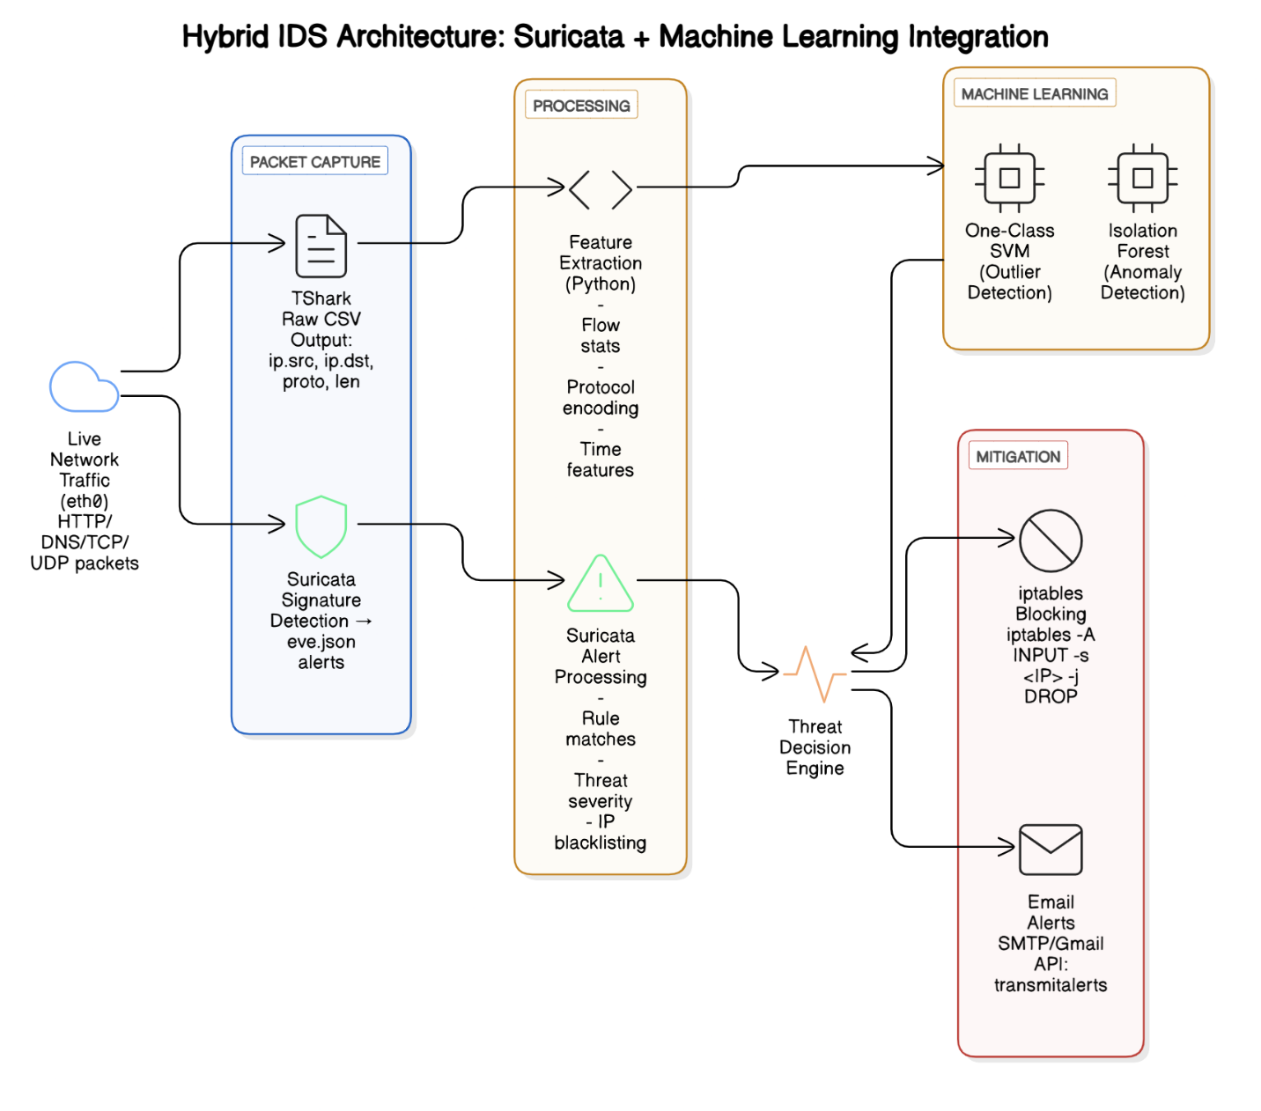
Flow Chart

Slide 19
Block Diagram

Slide 20
Block Diagram
Capture network traffic using Wireshark
Extract features of the data packets
Isolation forest detects potential anomalies
Anomalies identified and used to train SVM
If Malicio-us
Yes
No
Run Suricata
Admin alerted via Kibana
Automated blocking
End

Slide 21
System Requirements

Slide 22
System Requirements
Hardware Requirements
Processor: Intel Core i5 or higher
RAM: Minimum 8 GB
Storage: At least 50 GB free space
Network Interface: Ethernet adapter for packet capture
✅ Software Requirements
Operating System: Ubuntu Linux (preferred) or any Linux-based OS
Suricata: IDS engine for signature-based detection
Python: Version 3.8+ for feature extraction and ML integration
TShark: For raw packet capture and CSV output
Scikit-learn: For implementing One-Class SVM and Isolation Forest
Iptables: For threat mitigation via blocking rules
SMTP/Gmail API: For email alert functionality
Other Libraries: Pandas, NumPy, Matplotlib (for data processing and visualization)

Slide 23
Implementation

Slide 24
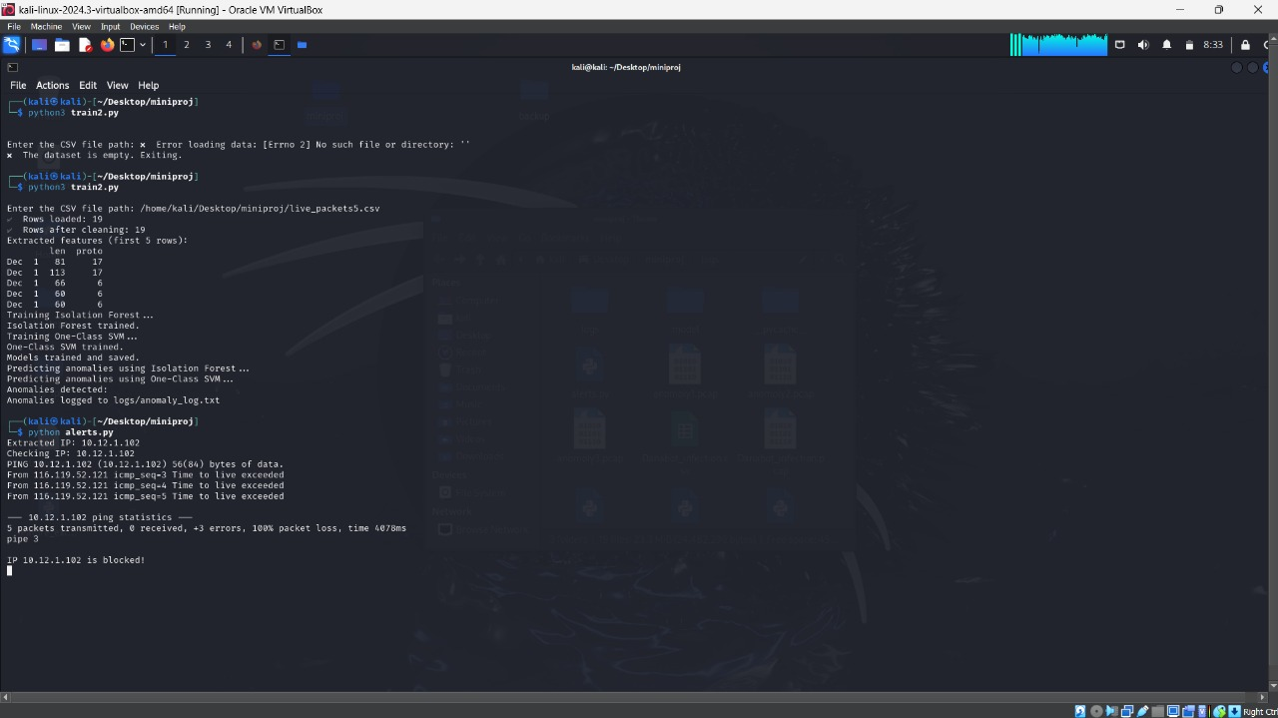
Implementation
Input:

Slide 25

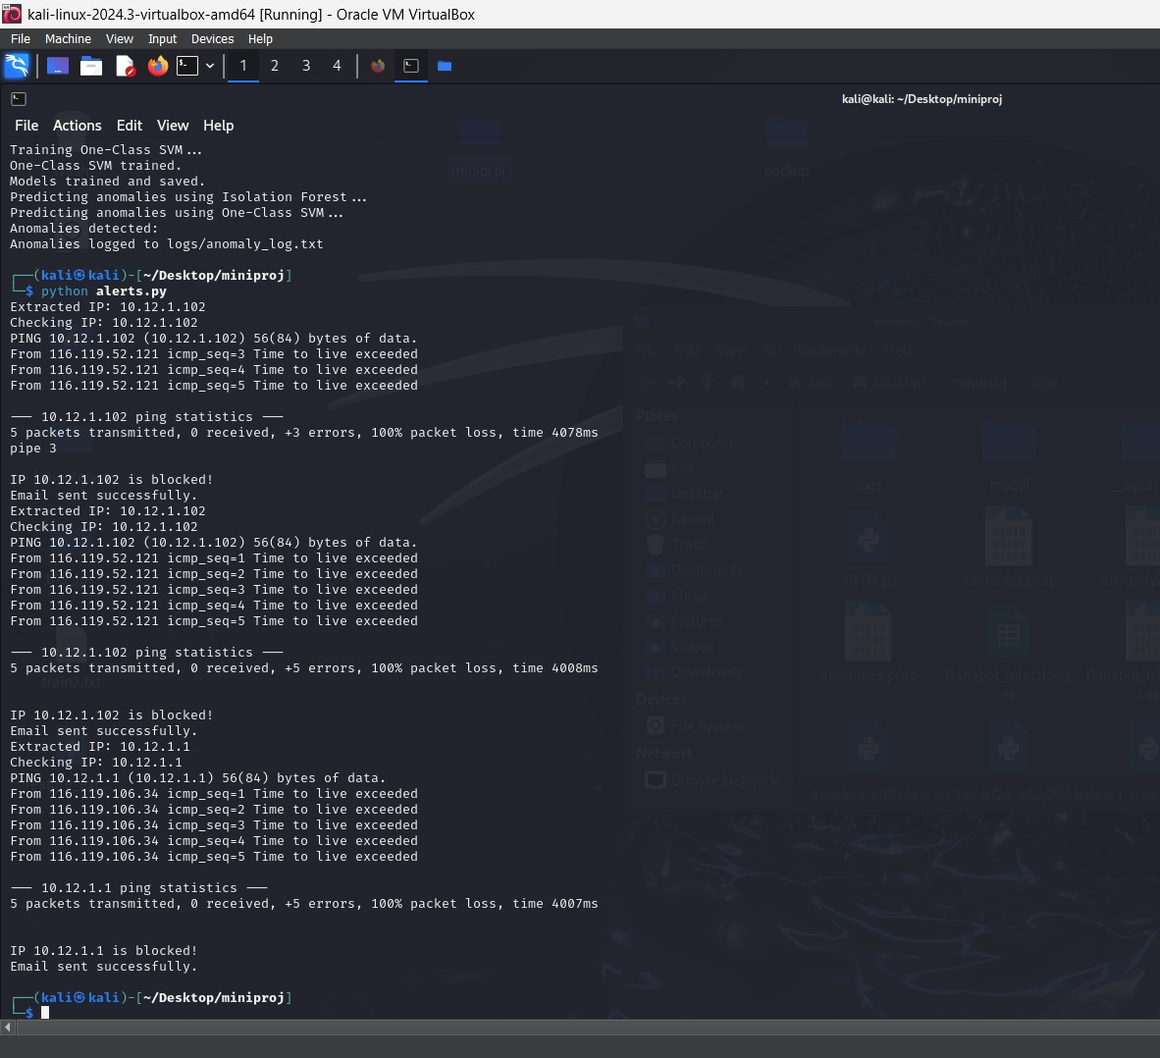
output:

Slide 26
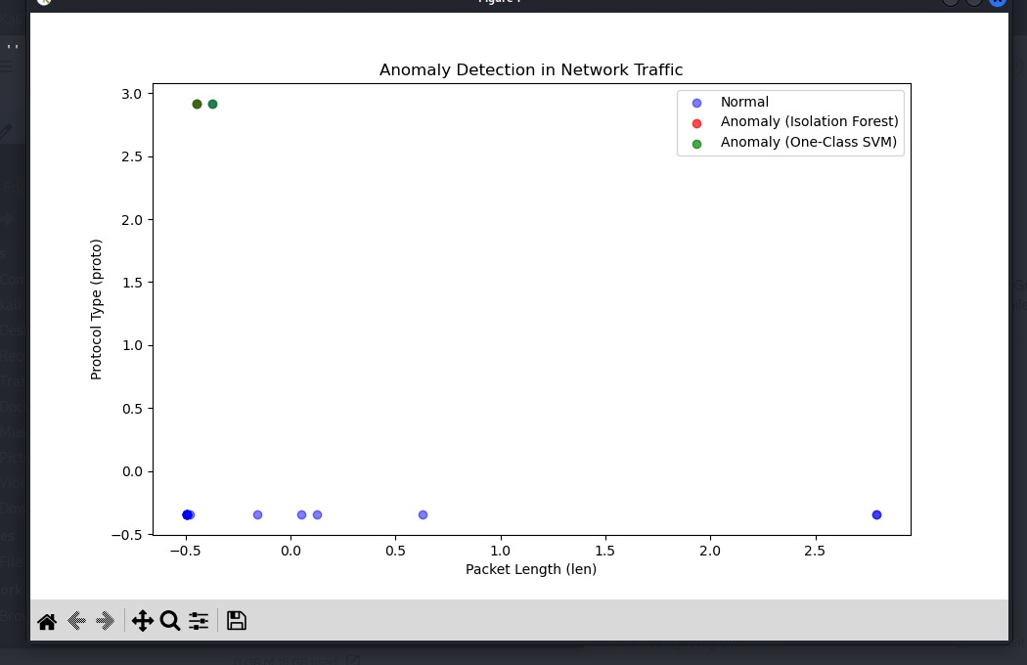
Implementation
Output:

Slide 27
Results

Slide 28
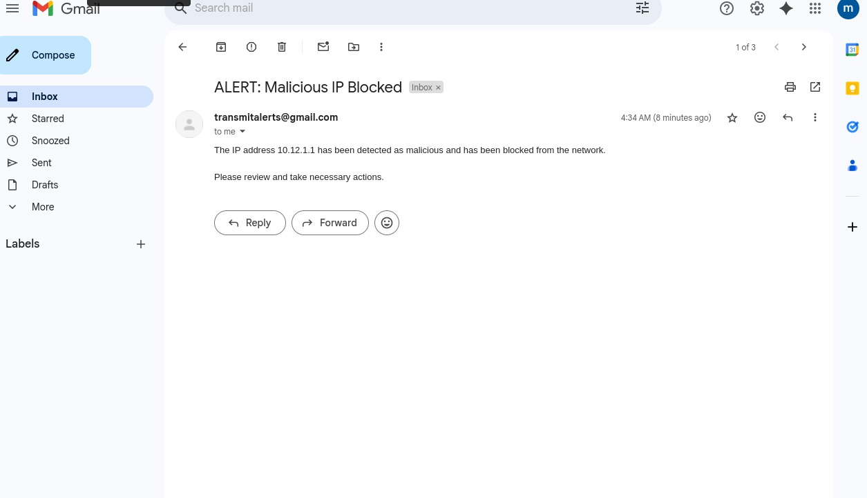
Results

Slide 29
Conclusion

Slide 30
Conclusion
The proposed Hybrid IDS successfully integrates Suricata's signature-based detection with machine learning-based anomaly detection, enhancing overall security.
Machine learning models like One-Class SVM and Isolation Forest help detect unknown threats by analyzing behavior patterns, reducing false negatives.
The system performs real-time monitoring, generates Suricata alerts, applies ML-based decisions, and takes automated actions such as IP blocking and email alerts.
This project demonstrates the effectiveness and scalability of combining traditional IDS methods with AI-driven techniques in securing modern networks.
Future improvements may include support for deep learning models, integration with SIEM tools, and deployment in cloud or enterprise environments.

Slide 31
Thank You!

